Slide 1
Powerlifting Performance Analysis
Hüseyin Can Kayım

Slide 2
Problem Statement & Dataset
Can we segment powerlifters based on performance metrics?
Sample: 2,000 rows using random state
Key variables: Age, lifts, total weight, sex, equipment etc.

Slide 3
Preprocessing Summary
Summary statistics were computed for key numeric features (e.g., mean, std dev).
Missing values were handled by removing records lacking essential numerical data.
The large dataset allowed us to filter without losing significance.
Categorical features identified: Sex, Equipment, Federation, etc.
Missing values in categorical columns were acknowledged but excluded from clustering.
Visual Aid: Distribution plots of key numeric attributes (distribution_plots.png)

Slide 4
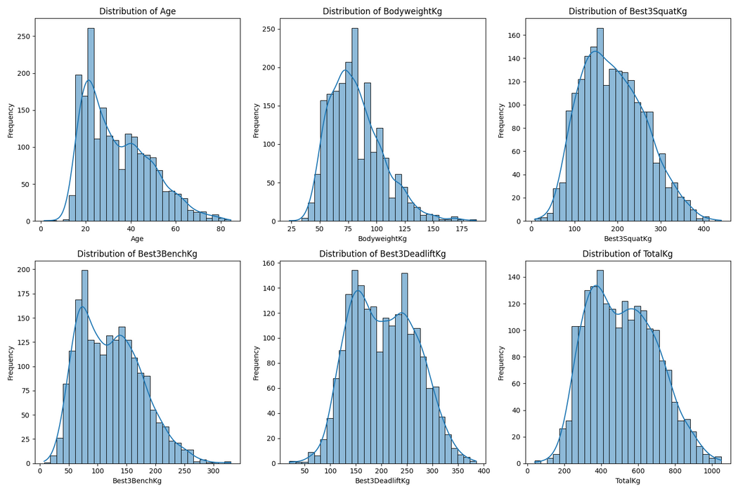
Age and bodyweight are normally distributed, with most lifters between 25–40 years old and 65–100 kg bodyweight.
Performance measures (TotalKg, Best3SquatKg, etc.) show a long right tail — top lifters skew the results upward.

Slide 5
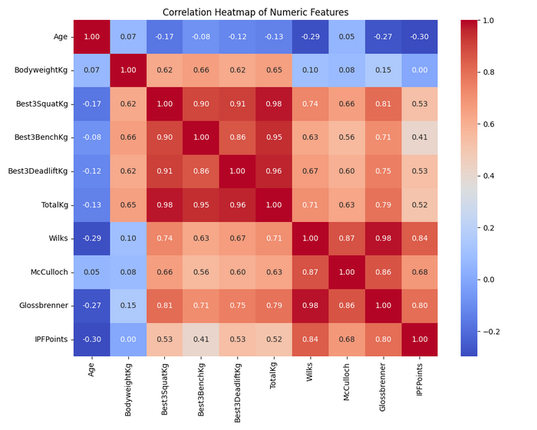
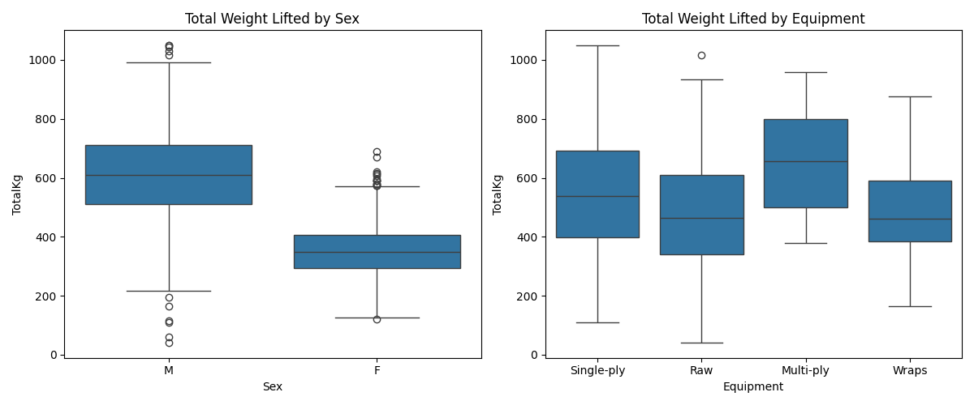
Exploratory Data Analysis
BodyweightKg has a moderate positive correlation with TotalKg, suggesting heavier athletes tend to lift more.
Strength scoring metrics (Wilks, Glossbrenner, IPFPoints) are also positively correlated with total lifted weight.
Most lifters are male and compete in the “Raw” or “Wraps” equipment categories.
Males tend to lift significantly more weight than females in total.
Lifters using equipment (like single-ply or multi-ply suits) generally post higher totals compared to raw lifters.

Slide 6
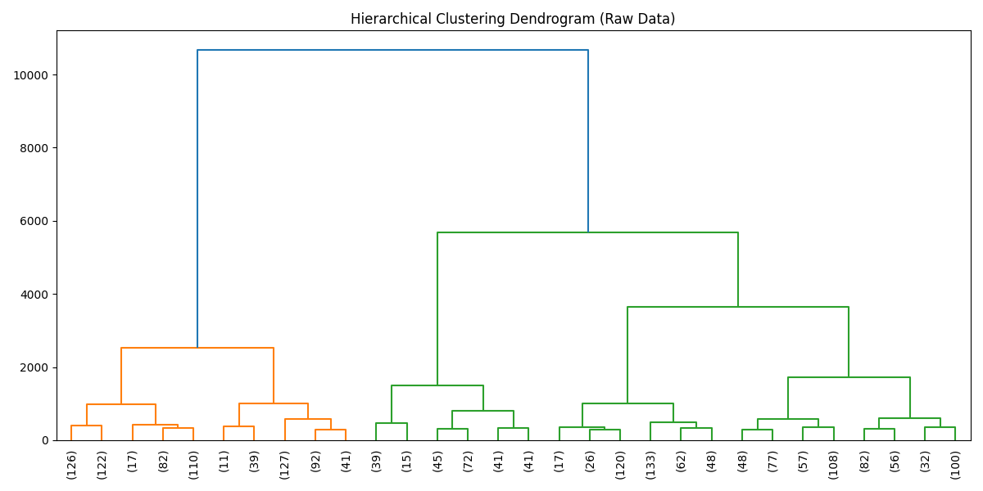
Hierarchical Clustering (Raw Data)
Used Ward’s linkage on raw data
No scaling features with large values dominate
Clusters less meaningful

Slide 7
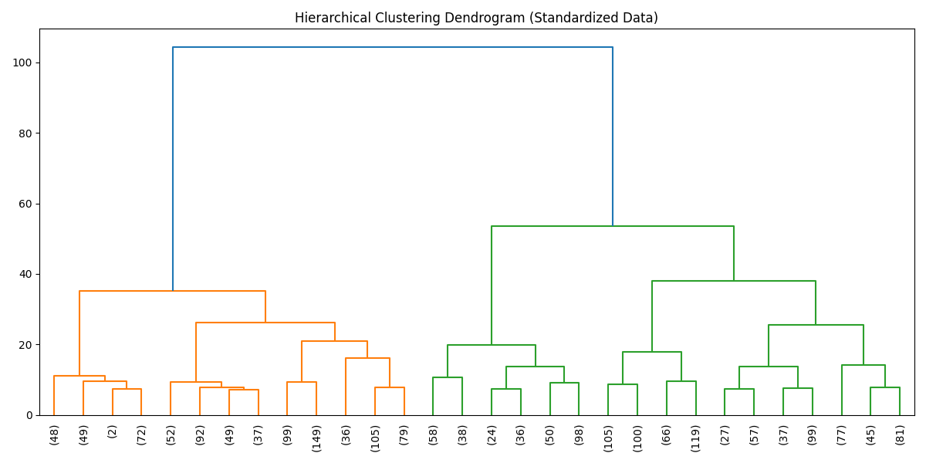
Hierarchical Clustering (Standardized)
StandardScaler used to normalize feature scales
Revealed more balanced and interpretable clusters
Shows why standardization is essential for clustering tasks

Slide 8
Week 1 Conclusion
Sampling and EDA provided good insights
Missing values handled appropriately
Standardization significantly impacted clustering results

Slide 9
Regression Models Overview
Goal: Predict total weight lifted (TotalKg)
Features used:
Numerical: Age, BodyweightKg
Categorical: Sex, Equipment, Event
Models implemented:
Linear Regression
K-Nearest Neighbors (KNN)
Decision Tree
Random Forest

Slide 10
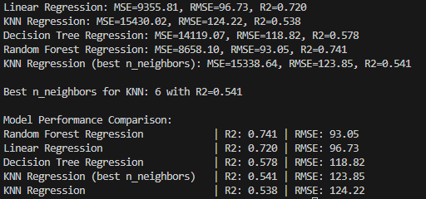
Regression Models Results

Slide 11
Classification Task Overview
Goal: Classify lifters as "strong" or "average" based on Wilks Score
Binary Classification:
Class 0: Below median Wilks Score
Class 1: Above median Wilks Score
Same features as regression
Models evaluated:
Logistic Regression
KNN Classifier
Decision Tree
Random Forest

Slide 12
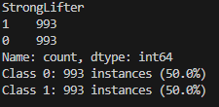
Data Balance Analysis
Perfect Natural Balance:
Class 0: 993 instances
Class 1: 993 instances
No downsampling needed
Using Wilks Score ensures fair classification across:
Different weight classes
Gender categories
Equipment types

Slide 13
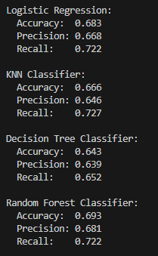
Model Performance
Best Overall: Random Forest Classifier
Most Consistent: Logistic Regression

Slide 14
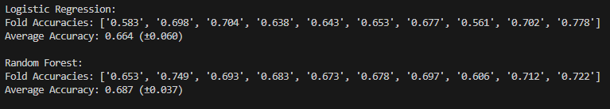
Cross-Validation Results
Logistic Regression: Stable performance across folds
Random Forest: More consistent across folds

Slide 15
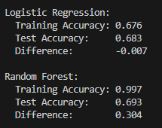
Overfitting Analys
Logistic Regression: Shows excellent generalization
Random Forest: Shows overfitting despite good test performance

Slide 16
Week 2 - Conclusions
Regression models help predict lifter performance using basic demographic and event features.
Classification into "strong" vs. "average" using Wilks Score yielded well-balanced classes.
Random Forest delivered highest accuracy, but showed signs of overfitting.
Logistic Regression offered more stable and generalizable results.
Model evaluation highlighted trade-offs between performance and generalization.

Slide 17
Feature Selection Analysis
Method: Mutual Information Classification
Top 5 Ranked Features:
1. WeightClassKg (0.406)
2. Best3BenchKg (0.364)
3. Best3DeadliftKg (0.353)
4. TotalKg (0.336)
5. Best3SquatKg (0.287)
Random Forest Performance with MI-selected Features:
Cross-validation Score: 90.65% ± 0.0199

Slide 18
Feature Selection Analysis
Method: Random Forest Feature Importances
Top 5 Ranked Features:
1. Best3DeadliftKg (0.232)
2. Best3BenchKg (0.201)
3. TotalKg (0.137)
4. Wilks (0.114)
5. WeightClassKg (0.101)
Random Forest Performance with RF-selected Features:
Cross-validation Score: 97.05% ± 0.0073

Slide 19
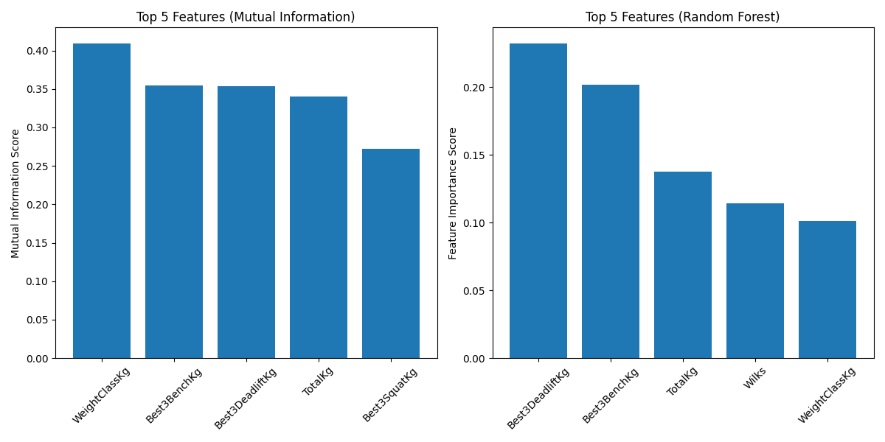
Feature Selection Analysis

Slide 20
Feature Selection Analysis
Feature Selection Differences:
Both methods agree on the importance of Best3BenchKg, Best3DeadliftKg, TotalKg, and WeightClassKg
The main difference is that Mutual Information includes Best3SquatKg, while Random Forest includes Wilks score
The ordering of importance is quite different between the methods

Slide 21
Feature Selection Analysis
Performance Comparison:
The Random Forest feature selection leads to better classification performance (97.05% vs 90.65%)
The Random Forest selection also results in more consistent predictions (lower standard deviation: ±0.0073 vs ±0.0199)

Slide 22
Feature Selection Analysis
Interpretation:
The Random Forest method seems to better capture the features that are most useful for classification
The inclusion of the Wilks score (which combines weight and total lifted weight) by the Random Forest method appears to be beneficial
Both methods confirm that lifting performance metrics (especially bench press and deadlift) are strong predictors of sex
The more stable performance of the Random Forest-selected features suggests they might be more robust predictors

Slide 23
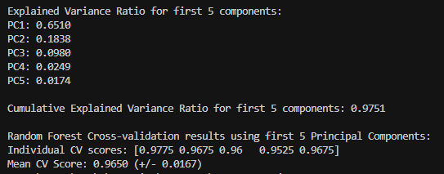
Principal Component Analysis (PCA)

Slide 24
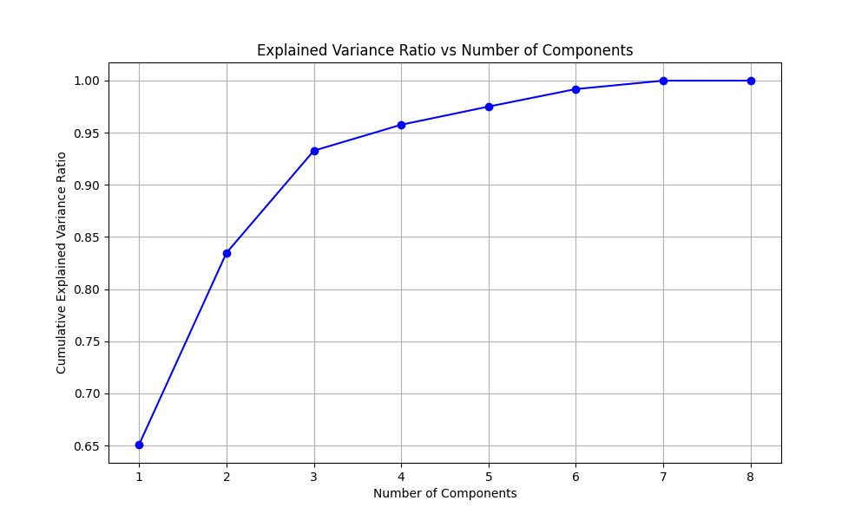
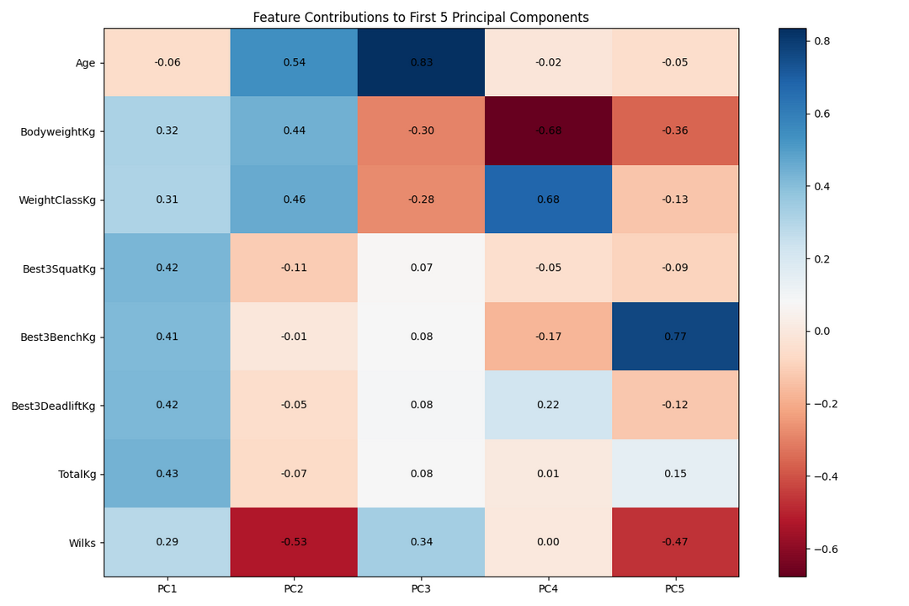
Principal Component Analysis (PCA)

Slide 25
Principal Component Analysis (PCA)
Variance Explanation:
The first 5 principal components capture 97.51% of the total variance in the data
The first component alone explains 65.10% of the variance
The second component adds another 18.38%
The remaining three components contribute smaller but still significant amounts

Slide 26
Principal Component Analysis (PCA)
Model Performance Comparison:
PCA-based model (5 PCs): 0.9650 (±0.0167)
Previous Random Forest with top 5 features: 0.9705 (±0.0073)
Previous Mutual Information top 5 features: 0.9065 (±0.0199)

Slide 27
Principal Component Analysis (PCA)
Analysis:
The PCA-based model performs very well (96.50% accuracy), slightly lower than the Random Forest feature selection (97.05%) but better than the Mutual Information selection (90.65%)
The PCA model's variance (±0.0167) is higher than the RF feature selection (±0.0073) but lower than the MI selection (±0.0199)
Using just 5 principal components captures almost all the variance (97.51%) while maintaining high classification performance
This suggests that the original 8 features contain some redundant information that PCA effectively compressed

Slide 28
Week 3 - Conclusions
Feature selection and PCA were used to improve model performance.
Random Forest-selected features gave the highest accuracy (97.05%) and most consistent results.
PCA compressed data into 5 components, retaining 97.5% of variance with strong accuracy (96.50%).
Both methods confirmed bench press, deadlift, and total weight as key predictors.
Random Forest feature selection was the most effective overall.

Slide 29
Project Summary
Problem Statement:
Identify patterns in lifter characteristics and outcomes,
Understand the relationships between bodyweight, equipment type, and federations, and
Use this analysis to support predictive modeling and guide competitive powerlifting goals.
Summary Statistics:
Sample Size: 2,000 lifters. Mean Age: 34.1 years.
Mean Bodyweight: 81.8 kg. Mean Total Lifted: 515.2 kg.
Missing Data: Minimal after preprocessing.

Slide 30
Data Selection & Preprocessing Summary
Data Source: OpenPowerlifting dataset.
Selection:
Filtered for essential columns: Best3SquatKg, Best3BenchKg, Best3DeadliftKg, Age, Country, MeetState, Tested.
Dropped rows with missing values in these columns.
Removed individual lift attempt columns.
Randomly sampled 2,000 rows for analysis.
Preprocessing:
Numeric and categorical summaries generated.
Missing values identified and handled.
Distributions of key numeric features visualized.

Slide 31
Exploratory Data Analysis Summary
Correlation Heatmap:
Numeric features show strong correlations, especially among lift totals and scoring metrics.
Boxplots:
Males lift more on average than females.
Equipped lifters have higher totals compared to raw.
Federation & Country Trends:
USA and a few federations dominate participation.
Distributions:
Age, bodyweight, and lift totals visualized for normality and outliers.

Slide 32
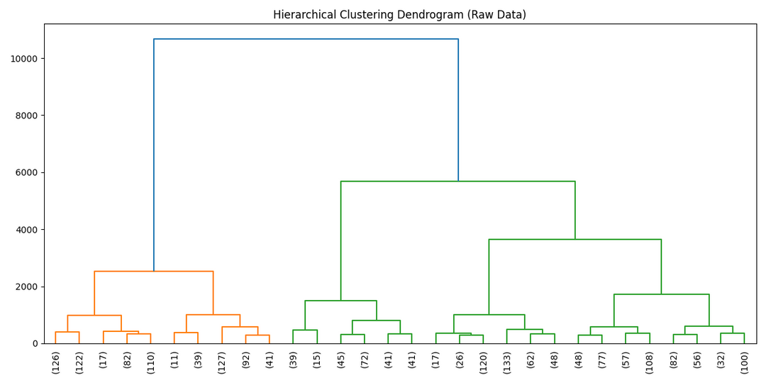
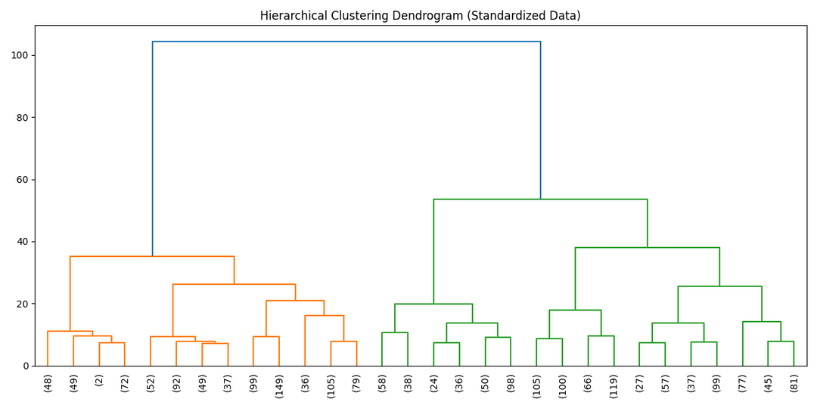
Clustering Summary
Hierarchical Clustering:
Performed on raw and standardized numeric features.

Slide 33
Regression Analysis Summary
Target:
Predicting TotalKg (total weight lifted).
Models Evaluated:
Linear Regression, KNN, Decision Tree, Random Forest.
Results:
Random Forest Regression achieved highest R².
KNN optimized for best n_neighbors.
Model performances compared by R² and RMSE.

Slide 34
Classification Analysis Summary
Target:
Binary classification: StrongLifter (Wilks above median).
Models Evaluated:
Logistic Regression, KNN, Decision Tree, Random Forest.
Results:
Random Forest and Logistic Regression performed best.
10-fold cross-validation and overfitting analysis included.
Class balancing performed by downsampling.

Slide 35
Feature Selection Summary
Methods Used:
Mutual Information and Random Forest feature importance.
Top Features (Both Methods):
Age, BodyweightKg, WeightClassKg, Best3SquatKg, Best3BenchKg, Best3DeadliftKg, TotalKg, Wilks.
Comparison:
Both methods agree on key predictors..
Model Evaluation:
Random Forest classifier with top 5 features from each method.
Cross-validation used to assess performance.

Slide 36
Principal Component Analysis Summary
PCA Performed on Numeric Features:
Standardized features before PCA.
First 5 principal components explain ~97.5% of variance.
Feature contributions visualized.
Modeling with PCA:
Random Forest classifier trained on first 5 PCs.
Performance compared to feature selection methods.

Slide 37
Thank You...
GitHub:
https://github.com/HCanKayim/Powerlifting-Performance-Analysis

